Slide 1

PREDICTING YOUTUBE HATE USING MACHINE LEARNING
Group b5: Areej Soleja, Amish Gautam, Alvaro Tapia Huaman

Slide 2
TABLE OF CONTENTS
Objectives
Data & Methods
Modeling & Analysis
Findings
Challenges and Future Scope
Conclusion

Slide 3
Objectives and expectations
Apply
Apply data integration to analyze the content of comments and identify correlations and patterns associated with YouTube video hate
Identify
Identify the most important features that contribute to the likelihood of a video receiving hateful comments
Develop
Develop a model to predict whether a YouTube video is likely to receive hateful comments

Slide 4
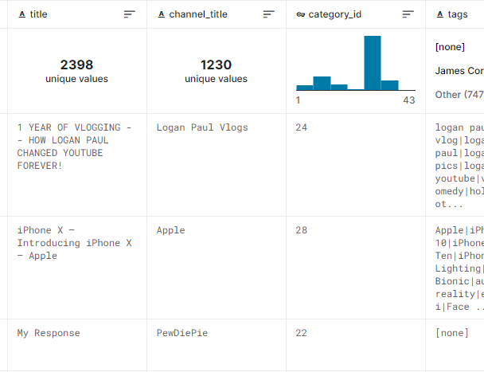
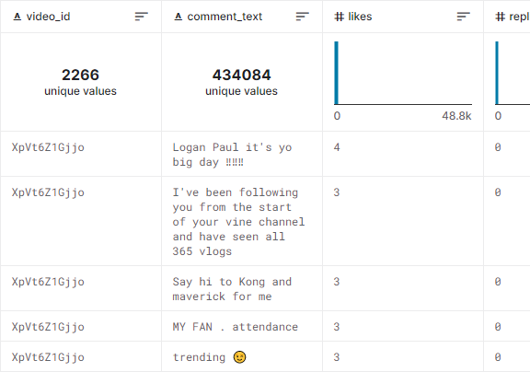
Data Sources and Joining
DATA
us videos
us comments

Slide 5
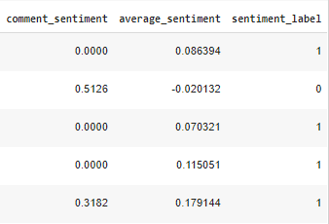
Methods: Sentiment Analysis
Average sentiment per video grouped by video ID
Feature extraction via forming a new column that gives a binary representative value (0 is negative and 1 is positive)

Slide 6
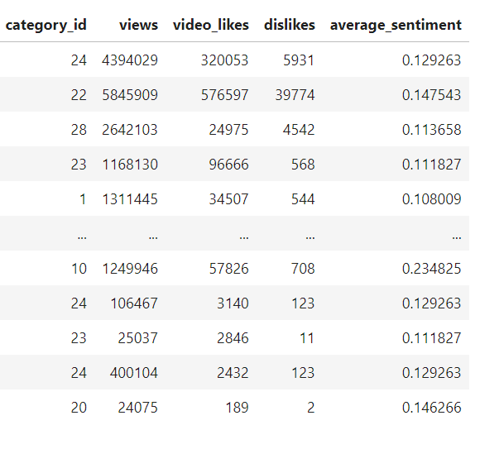
Methods: Feature selection
Deciding important numerical features for the model

Slide 7
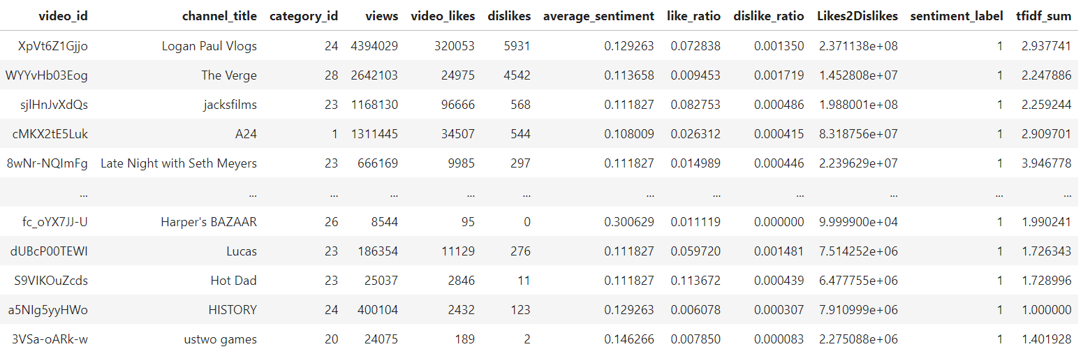
Methods: Feature Extraction
TF-IDF sum and Sentiment Scores kind of were extracted features
We calculated Like/Views Ratio, Dislike/Views Ratio and Like to Dislike Ratio

Slide 8
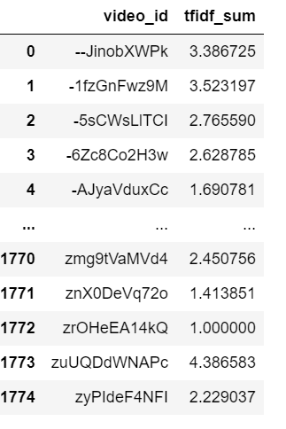
Methods: TF-IDF
TF-IDF performed on video tags. (eg. Funny|humor|MrBeast)
Each tag was assigned a TF-IDF score and we summed it up per video to find total weight

Slide 9
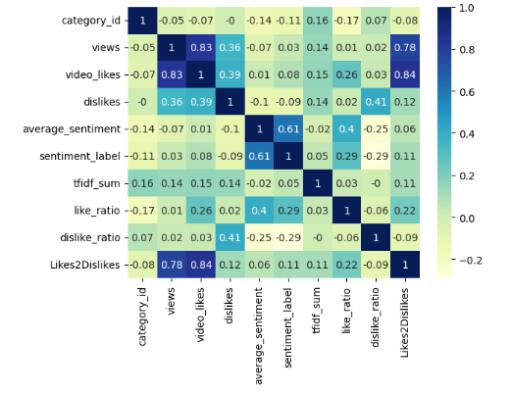
Correlation matrix

Slide 10
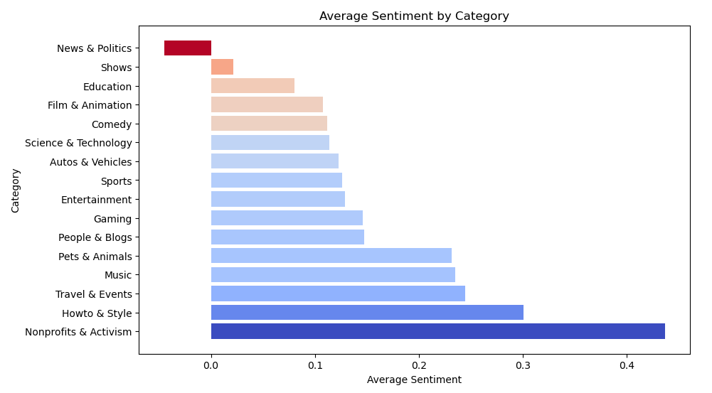
CATEGORY SENTIMENT ANALYSIS
News and Politics is the category with the most amount of negative sentiment

Slide 11
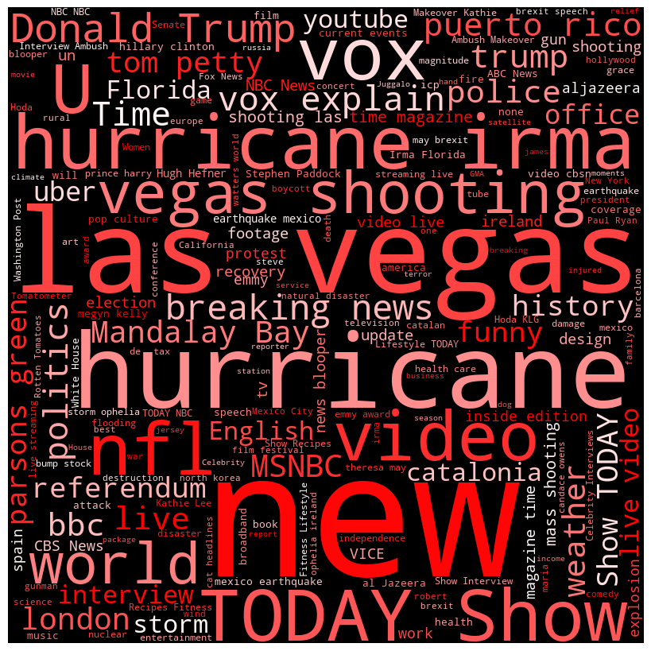
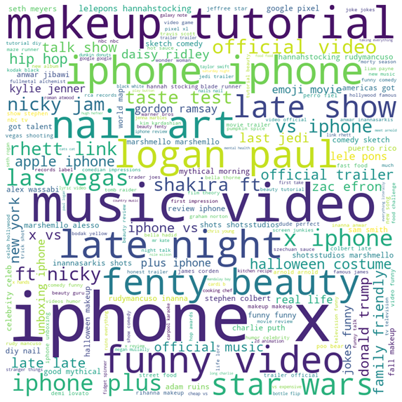
WORLD CLOUD
Most Popular and Most Hated words respectively

Slide 12
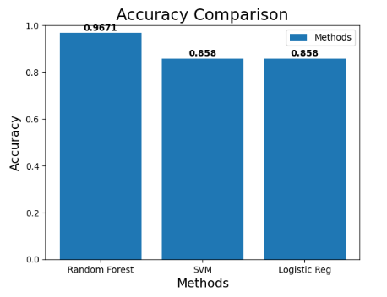
Model selection
Random Forest model had the highest accuracy with: 0.9671
Anticipated model by ChatGPT: Random Forest model
Fitted the Trained and Tested Data using Random Forest model

Slide 13
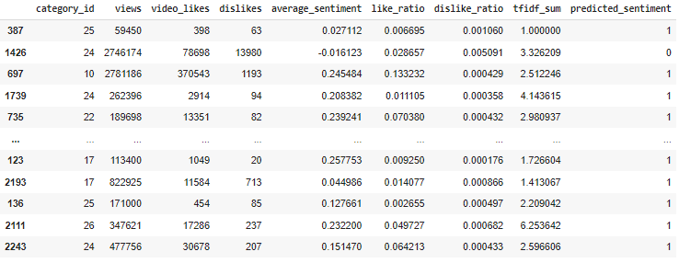
Model prediction

Slide 14
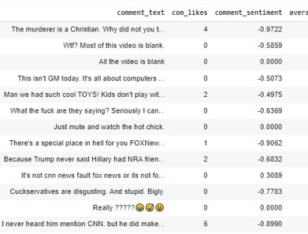
Interesting FINDINGs
Videos that contain politic flairs and ones that are blank garner a significant amount of hate

Slide 15
Usage of CHatgpt
Ideas on how to deal with tags
What model to use?
Issues when modeling due to target label was continous so offered new alternatives
Feature selection
Helpful in explanation of not ideal findings

Slide 16
FUTURE SCOPE
Expand its application to other social media platforms, such as Twitter or Facebook. We could also consider incorporating natural language processing (NLP) techniques to analyze the content of comments themselves, rather than just the metadata associated with the video.
Use the insights gained to inform content creators about the types of content that are more likely to elicit negative comments from viewers, so that they can produce better content.

Slide 17

CONCLUSION
We were able to create a model that shows us the importance of certain features when it comes to creating YouTube videos such as category.
We were able to validate our findings, and with the continued growth of online content and the increasing importance of content moderation, our model has significant potential for further development and application.

